Slide 1

ECE 1710: Power Distribution Engineering and Smart Grids
Lecture 8
Dr. Robert Kerestes
University of Pittsburgh
Swanson School of Engineering
Department of Electrical and Computer Engineering
Notes:
Instructions for editing school and department titles:
Select from menu: View > Master > Slide Master
Click on each text area you wish to edit. Text will become editable.

Slide 2
Outline
Outline of Lecture No. 8
Module #1: Concentric Neutral Cable
Module #2: Concentric Neutral Example
Module #3: Tape-Shielded Cables
Module #4: Parallel Underground Lines

Slide 3
Learning Objectives
Learning Objectives:
Calculate the primitive and phase impedance matrices for concentric neutral cables
Calculate the primitive and phase impedance matrices for tape-shielded neutral cables
Calculate the primitive and phase impedance matrices for parallel underground oines
Write the matrix equation for voltage drop across a transmission line

Slide 4
Concentric Neutral Cable
Module #1

Slide 5
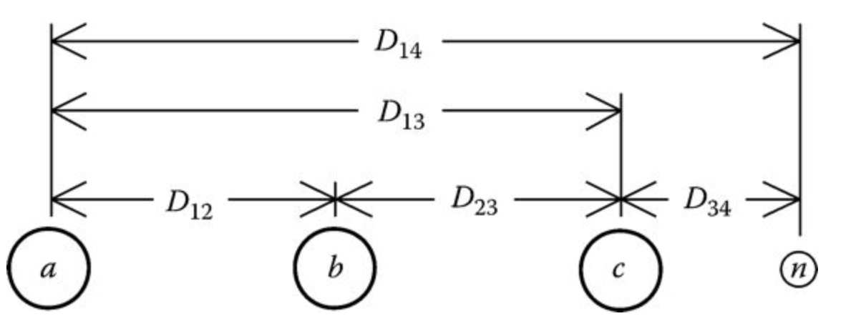
Concentric Neutral Cable
Module #1
Shown below is the general configuration of three underground cables (concentric neutral or tape-shielded) with an additional neutral conductor.

Slide 6
Concentric Neutral Cable
Module #1
There are two popular types of underground cables
Concentric neutral cable
Tape shield cable

Slide 7
Concentric Neutral Cable
Module #1
There are two popular types of underground cables
Concentric neutral cable
Tape shield cable
Underground circuits will produce a 7 x 7 primitive impedance matrix if there is a neutral and a 6 x 6 if there is not a neutral

Slide 8
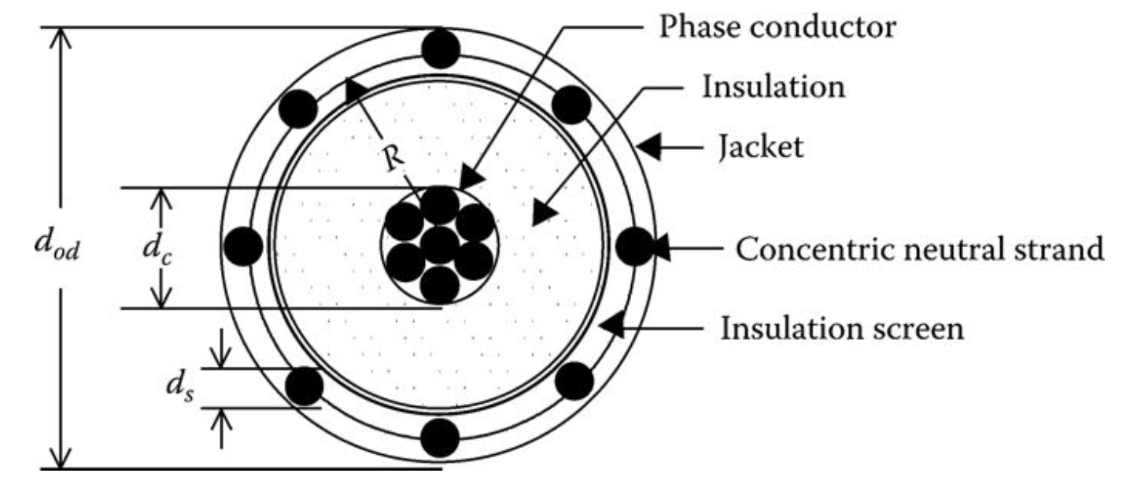
Concentric Neutral Cable
Module #1
Shown below is a drawing of a concentric neutral cable

Slide 9
Concentric Neutral Cable
Module #1
In order to apply Carson’s equations to this cable, the following data needs to be extracted from a table of underground cables (Appendices A and B).
d_{c} = phase conductor diameter (in.)
d_{od} = nominal diameter over the concentric neutrals of the cable (in.)
d_{s} = diameter of a concentric neutral strand (in.)
GMR_{c} = geometric mean radius of the phase conductor (ft)
GMR_{s} = geometric mean radius of a neutral strand (ft)
r_{c} = resistance of the phase conductor (Ω/mile)
r_{s} = resistance of a solid neutral strand (Ω/mile)
k = number of concentric neutral strands

Slide 10
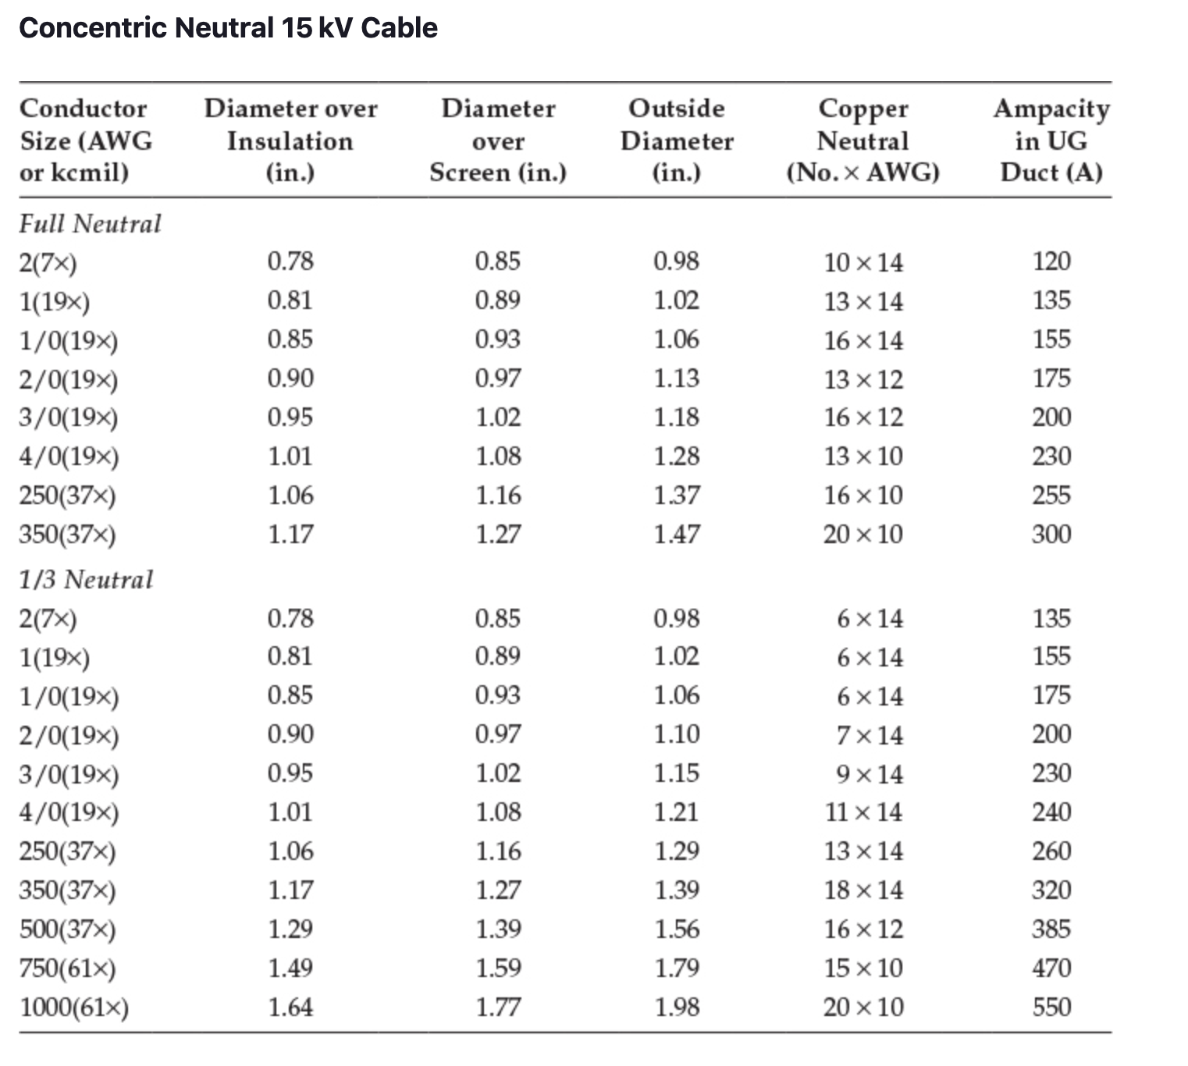
Module #1

Slide 11
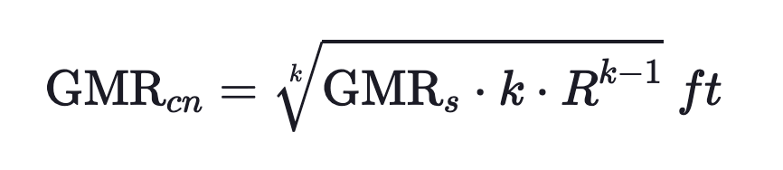
Concentric Neutral Cable
Module #1
The GMRs of the phase conductor and a neutral strand are obtained from a standard table of conductor data (Appendix A).
The equivalent GMR of the concentric neutral is computed using the equation for the GMR of bundled conductors used in high-voltage transmission lines:

Slide 12
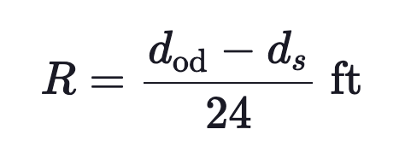
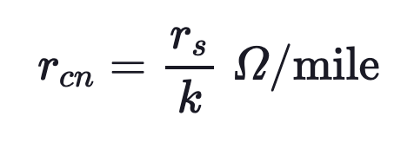
Concentric Neutral Cable
Module #1
R = radius of a circle passing through the center of the concentric neutral strands
The equivalent resistance of the concentric neutral is:

Slide 13
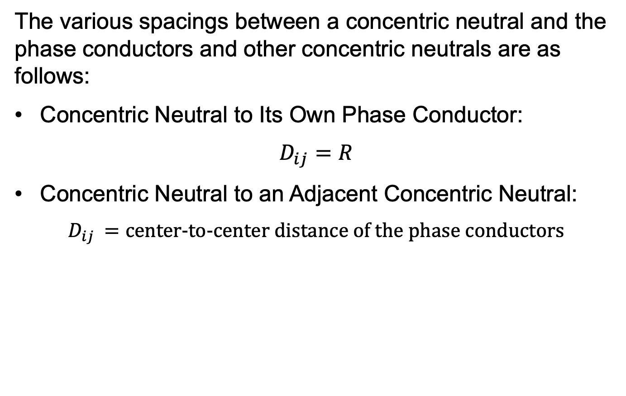
Concentric Neutral Cable
Module #1
The various spacings between a concentric neutral and the phase conductors and other concentric neutrals are as follows:
Concentric Neutral to Its Own Phase Conductor:
$$D_{ij}=R$$
Concentric Neutral to an Adjacent Concentric Neutral:
$$D_{ij }=\text{center}\text{−}\text{to}\text{−}\text{center} \text{distance} \text{of} \text{the} \text{phase} \text{conductors}$$

Slide 14
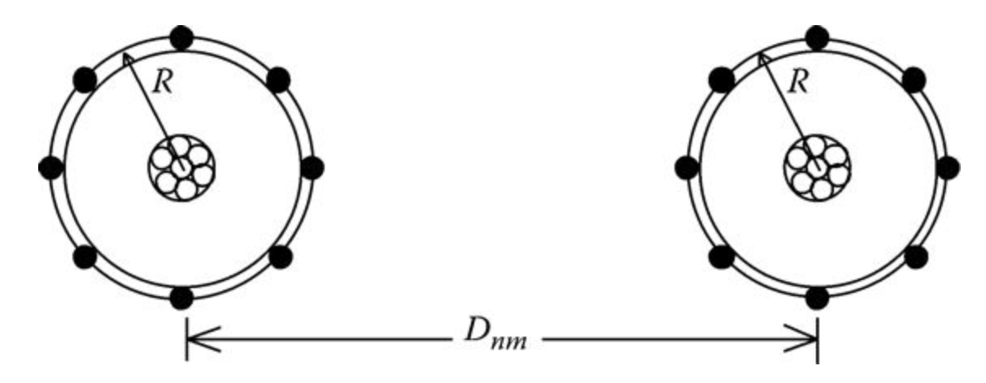
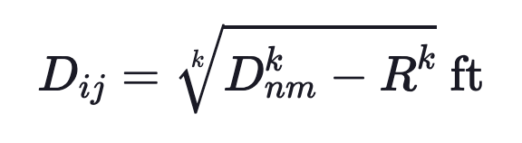
Concentric Neutral Cable
Module #1
Concentric Neutral to an Adjacent Phase Conductor

Slide 15
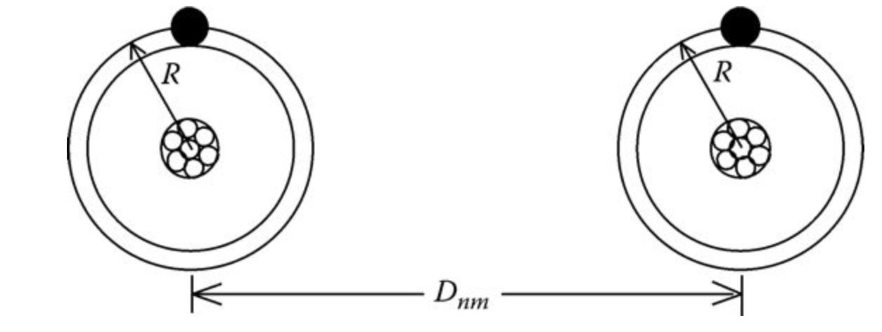
Concentric Neutral Cable
Module #1
The distance between cables will be much greater than the radius R; so a good approximation of modeling the concentric neutral cables is shown in below. In this figure, the concentric neutrals are modeled as one equivalent conductor (shown in black) directly above the phase conductor.

Slide 16
Concentric Neutral Cable
Module #1
n applying the Modified Carson’s Equations, the numbering of conductors and neutrals is important. For example, a three-phase underground circuit with an additional neutral conductor must be numbered as:
1 = phase a Conductor #1
2 = phase b Conductor #2
3 = phase c Conductor #3
4 = neutral of Conductor #1
5 = neutral of Conductor #2
6 = neutral of Conductor #3
7 = additional neutral conductor (if present)

Slide 17
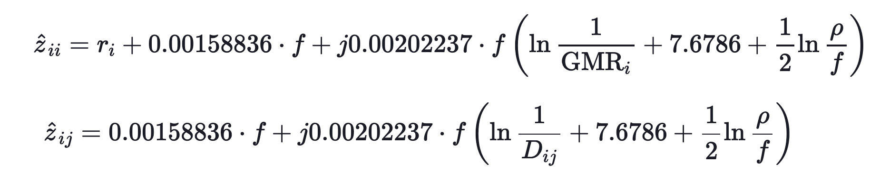
Concentric Neutral Cable
Module #1
Recall modified Carson’s equations are:

Slide 18
Concentric Neutral Cable
Module #1
Question: A three-phase concentric neutral underground transmission line with no neutrals will be a _____ x _____ matrix

Slide 19
Concentric Neutral Cable
Module #1
Question: A concentric neutral cable with 10 neutral strands, each with a resistance of 1Ω, will have an equivalent resistance of ________ Ω

Slide 20
Concentric Neutral Cable
Module #1
Question: A three-phase concentric neutral underground transmission line with no neutrals will be a _____ x _____ matrix

Slide 21
Module #2
Concentric Neutral Example

Slide 22
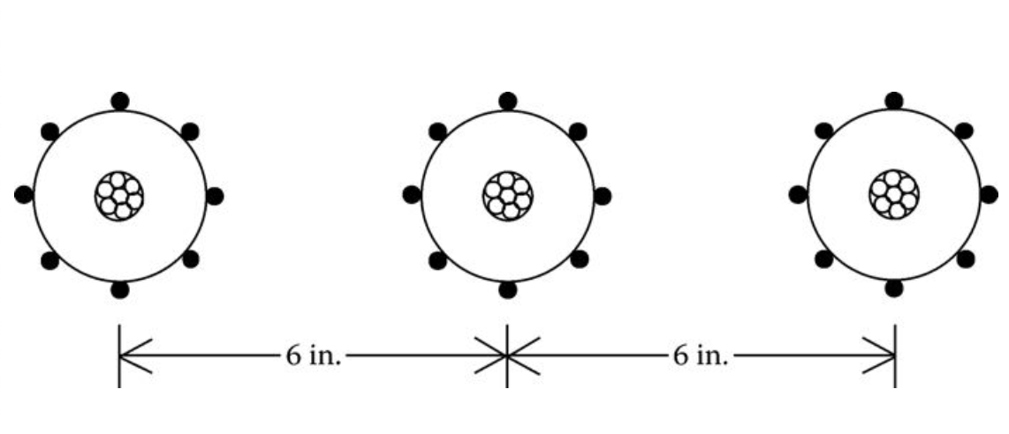
Concentric Neutral Example
Module #2
Three concentric neutral cables are buried in a trench with spacings as shown in the figure below
The cables are 15 kV, 250,000 CM stranded all aluminum with k = 13 strands of #14 annealed coated copper wires (1/3 neutral). The outside diameter of the cable over the neutral strands is 1.29 in. Determine the phase impedance matrix and the sequence impedance matrix.

Slide 23
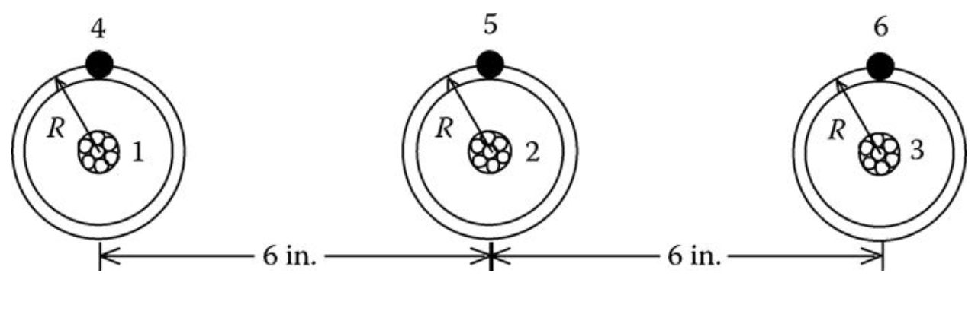
Concentric Neutral Example
Module #2
The equivalent model for these cables is shown below

Slide 24
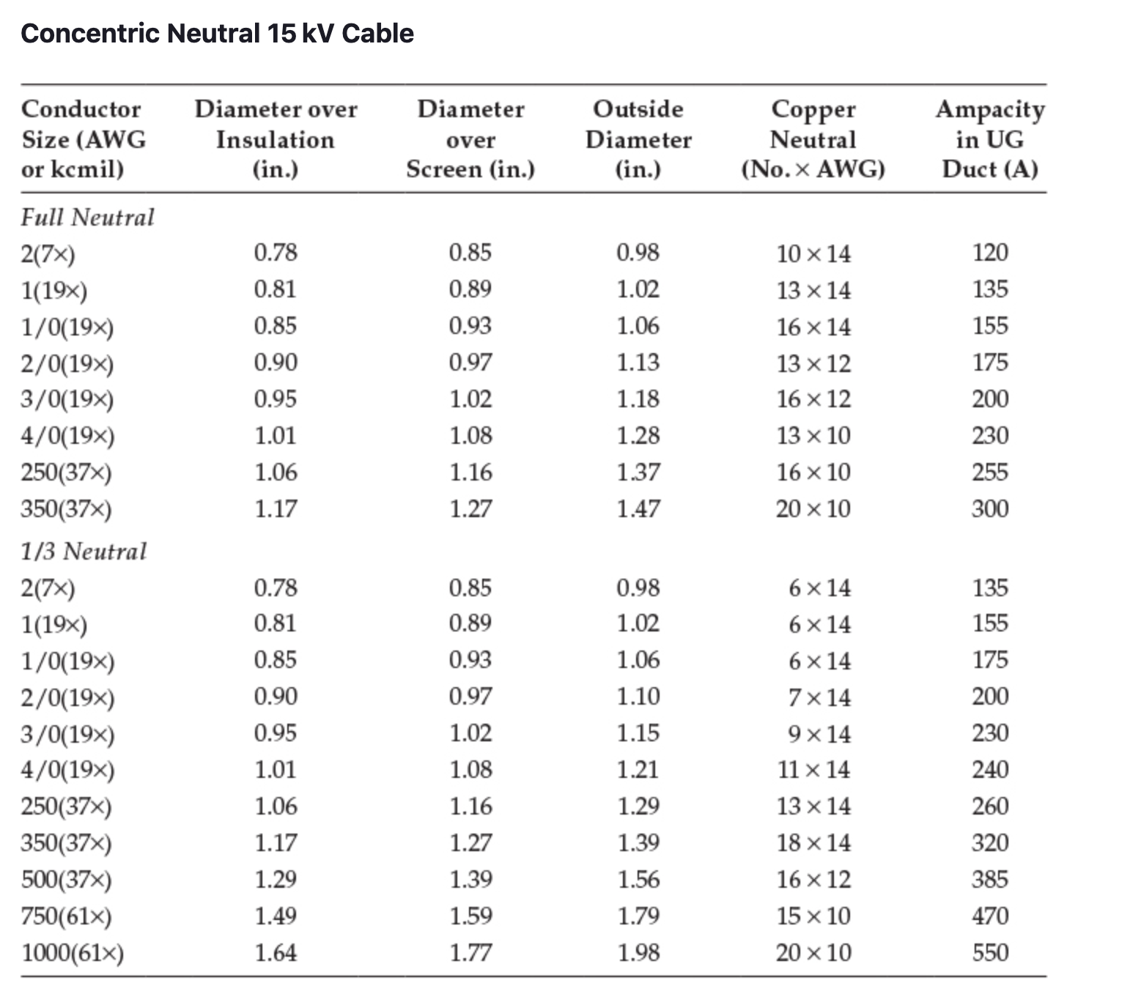
Module #2

Slide 25
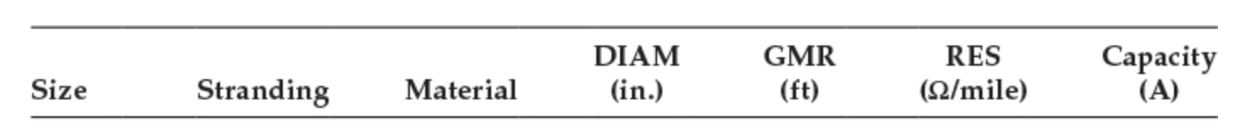
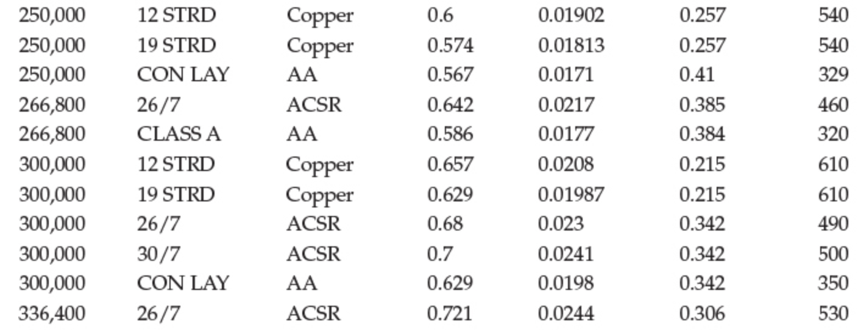
Module #2

Slide 26
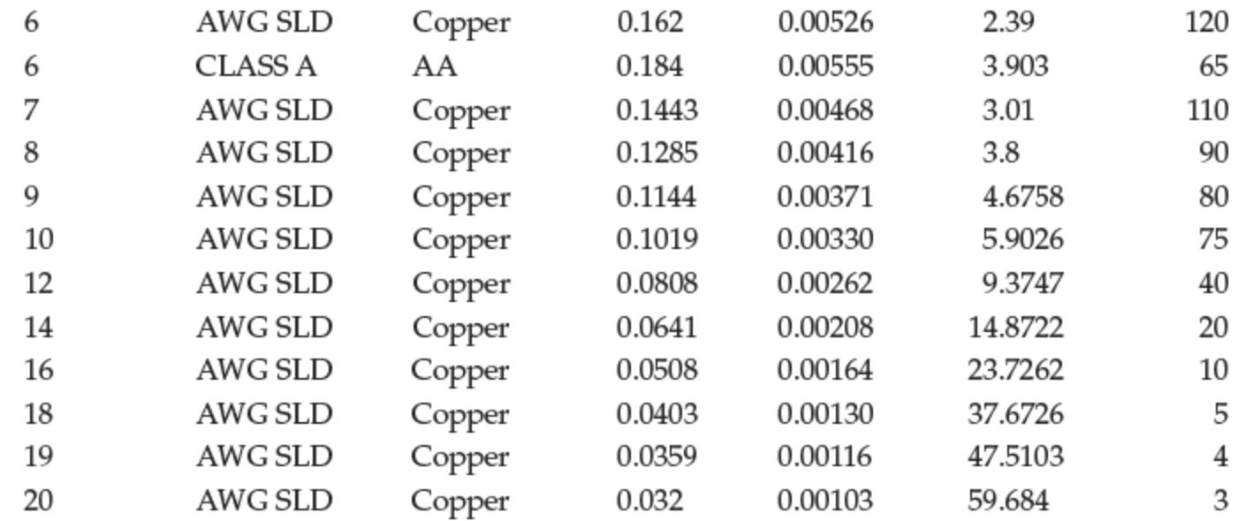
Module #2

Slide 27
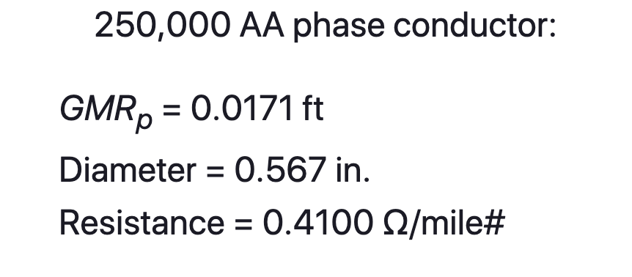
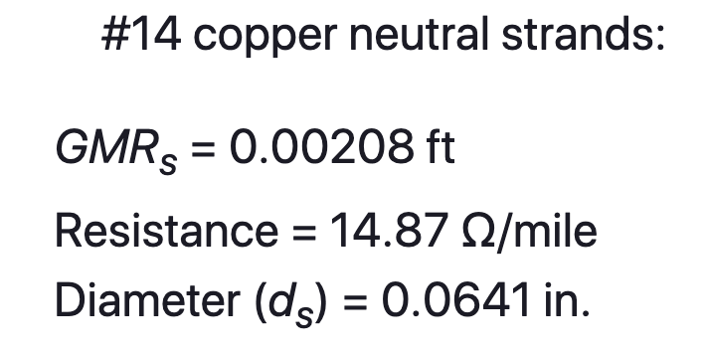
Concentric Neutral Example
Module #2
The data for the phase and neutral conductors is

Slide 28
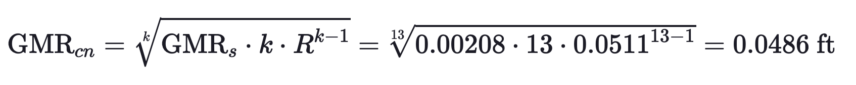
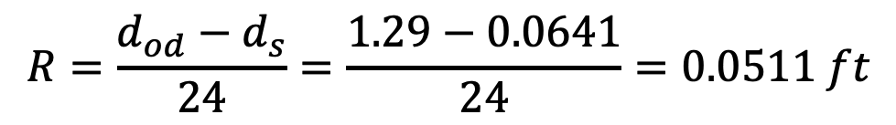
Concentric Neutral Example
Module #2
We then can calculate radius of the circle passing through the center of the strands
$$R=\frac{d_{od}−d_{s}}{24}=\frac{1.29−0.0641}{24}=0.0511 ft$$
Then using that to calculate the equivalent GMR

Slide 29
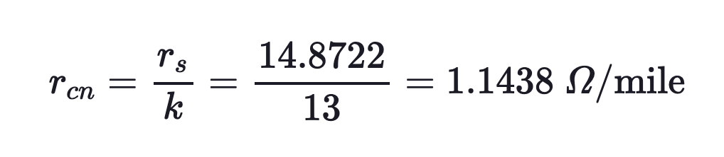
Concentric Neutral Example
Module #2
Calculating the equivalent resistance for the concentric neutral conductor

Slide 30
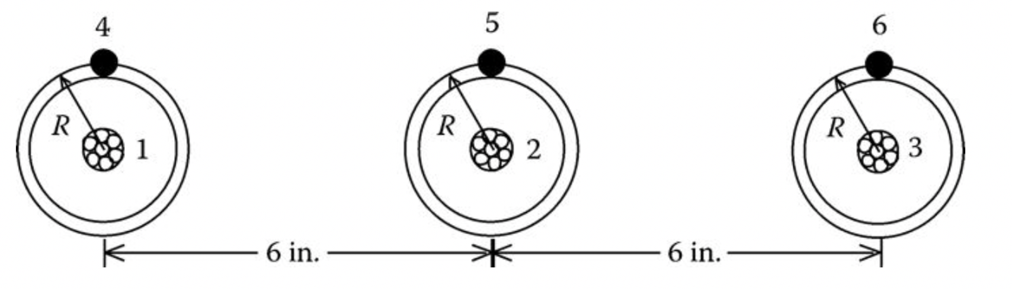
Concentric Neutral Example
Module #2
The coordinates for the conductors can be defined where the center of the phase conductors are at a y-coordinate of 0. Centering the center conductor
(0.5,0)
(-0.5,0)
(0,0)

Slide 31
Concentric Neutral Example
Module #2
The neutrals use the equivalent resistance and equivalent GMR are used for the concentric neutrals.
Modified Carson’s equations can then be used to solve for the impedance elements of the primitive impedance matrix.

Slide 32
Concentric Neutral Example
Module #2
Below is the output of a MATLAB Script which calculates the primitive impedance matrix.

Slide 33
Concentric Neutral Example
Module #2
Applying the Kron reduction yields

Slide 34
Module #3
Tape-Shielded Cables

Slide 35
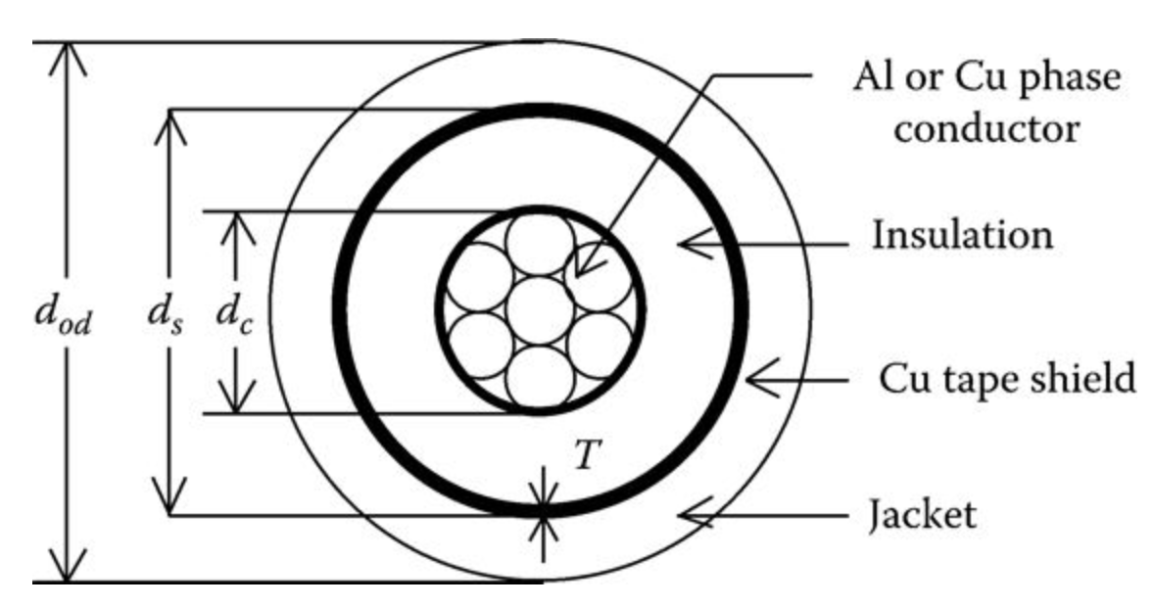
Tape-Shielded Cables
Module #3
The figure below shows a simple detail of a tape-shielded cable.

Slide 36
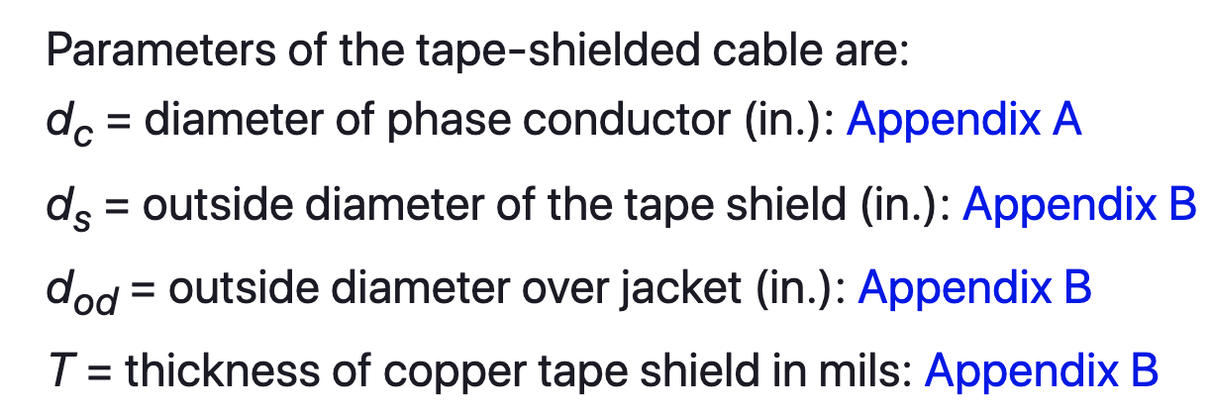
Tape-Shielded Cables
Module #3
For the tape shielded cable

Slide 37
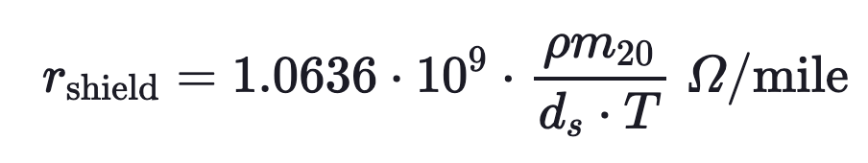
Tape-Shielded Cables
Module #3
The resistance of the tape shield is given by:
This resistance of the tape shield given assumes a resistivity (ρm₂₀) of 1.7721 · 10⁻⁸ Ω-m and a temperature of 20°C. The outside diameter of the tape shield ds is given in inches, and the thickness of the tape shield T is in mils.

Slide 38
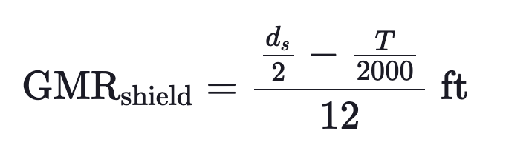
Tape-Shielded Cables
Module #3
The GMR of the tape shield is the radius of a circle passing through the middle of the shield and is given by:

Slide 39
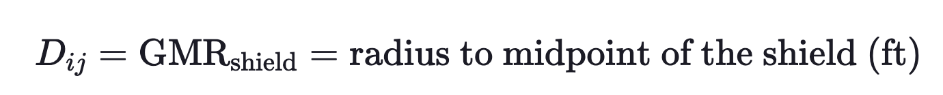
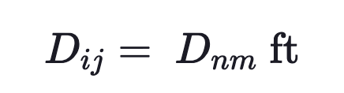
Tape-Shielded Cables
Module #3
Tape Shield to its Own Phase Conductor
Tape Shield to an Adjacent Tape Shield
Tape Shield to an Adjacent Phase or Neutral Conductor
where D_{nm} = center-to-center distance between phase conductors.

Slide 40
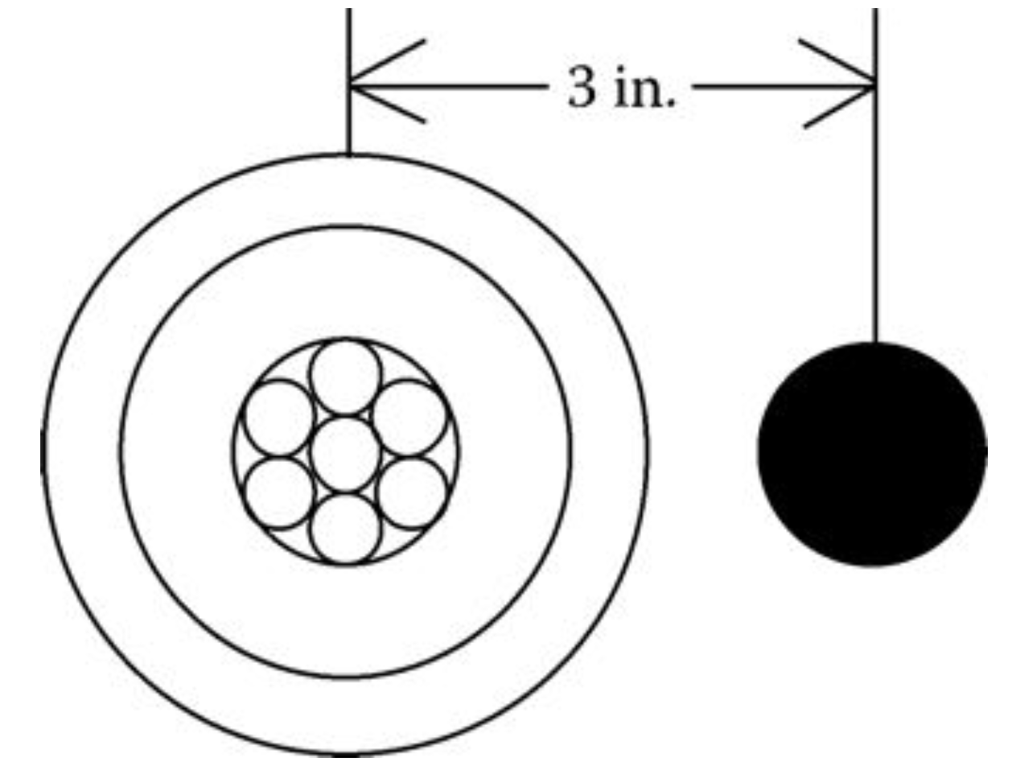
Tape-Shielded Cables
Module #3
Example: A single-phase circuit consists of a 1/0 AA, 220 mil insulation tape-shielded cable and a 1/0 CU neutral conductor. The single-phase line is connected to phase b. Determine the phase impedance matrix.

Slide 41
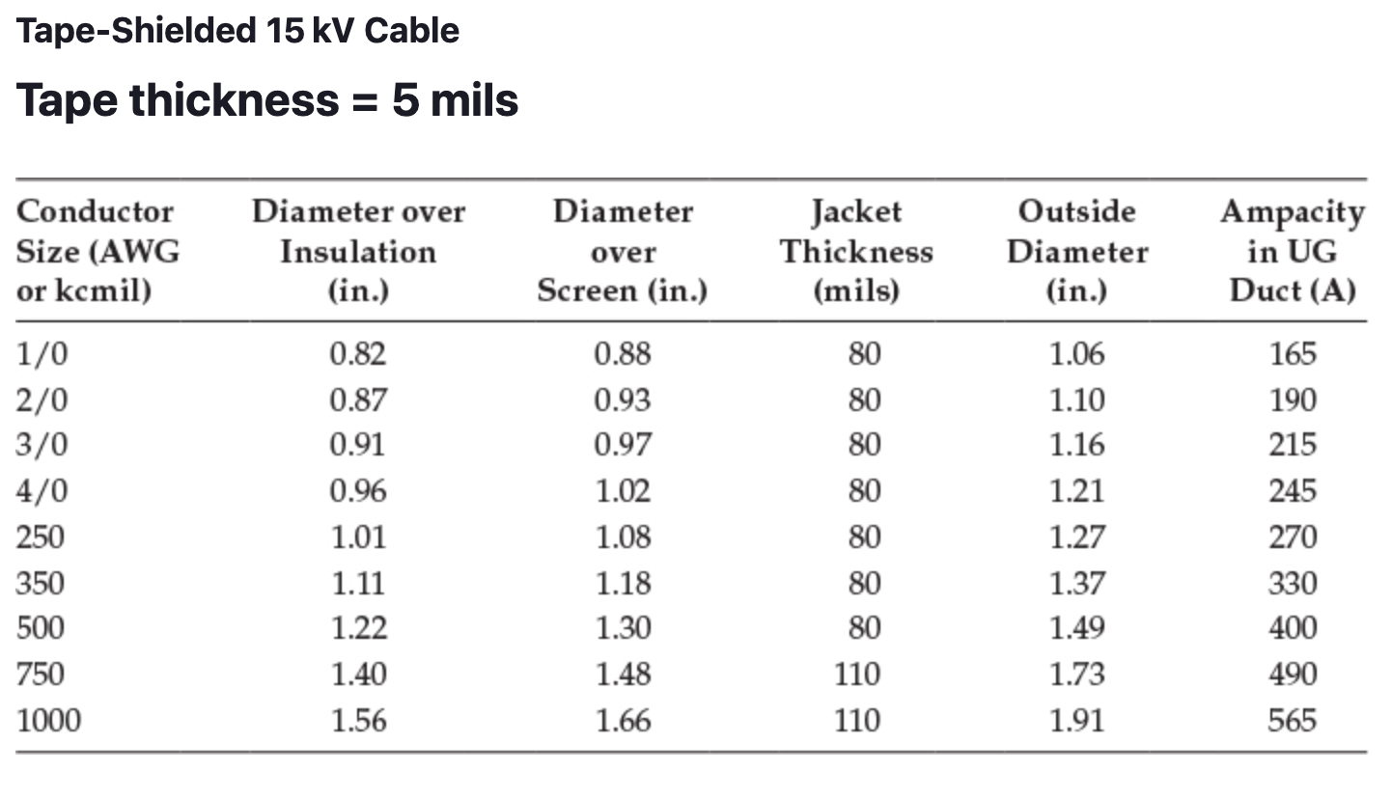
Tape-Shielded Cables
Module #3

Slide 42
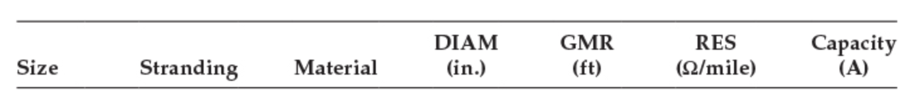
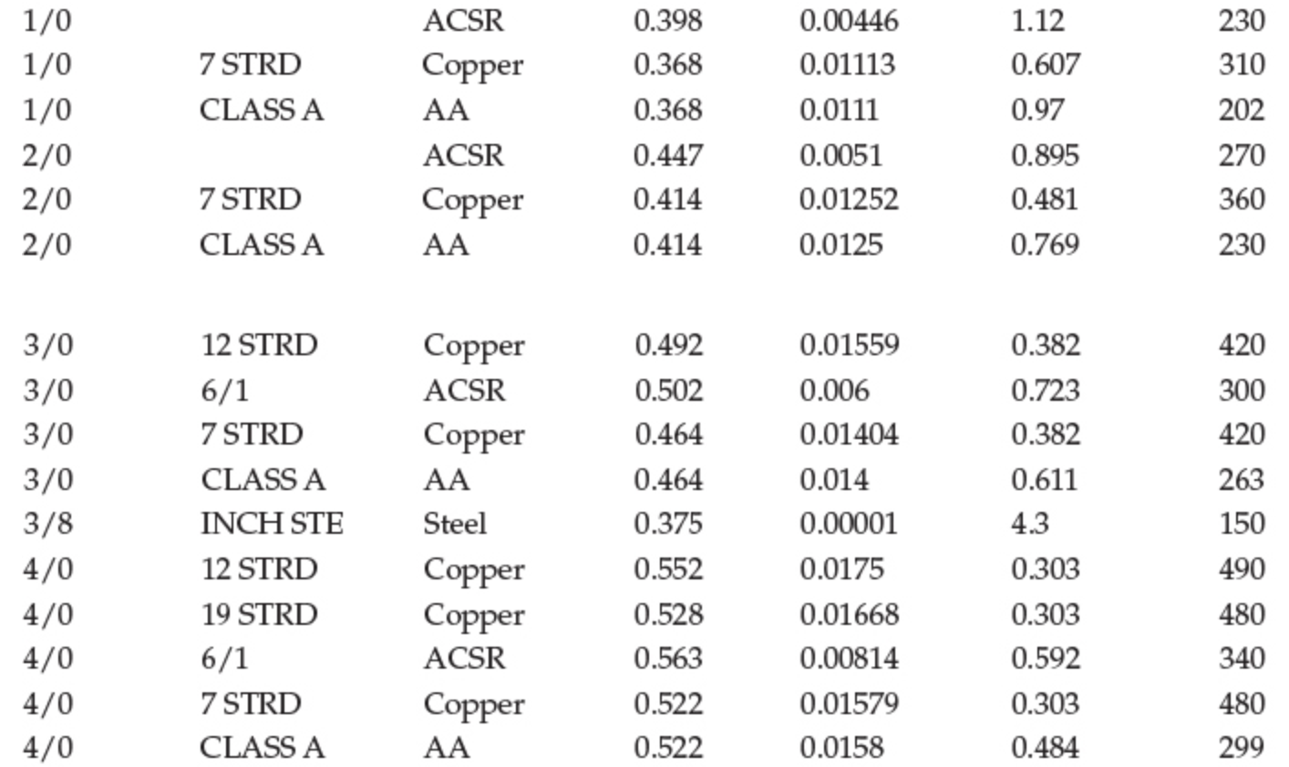
Tape-Shielded Cables
Module #3

Slide 43
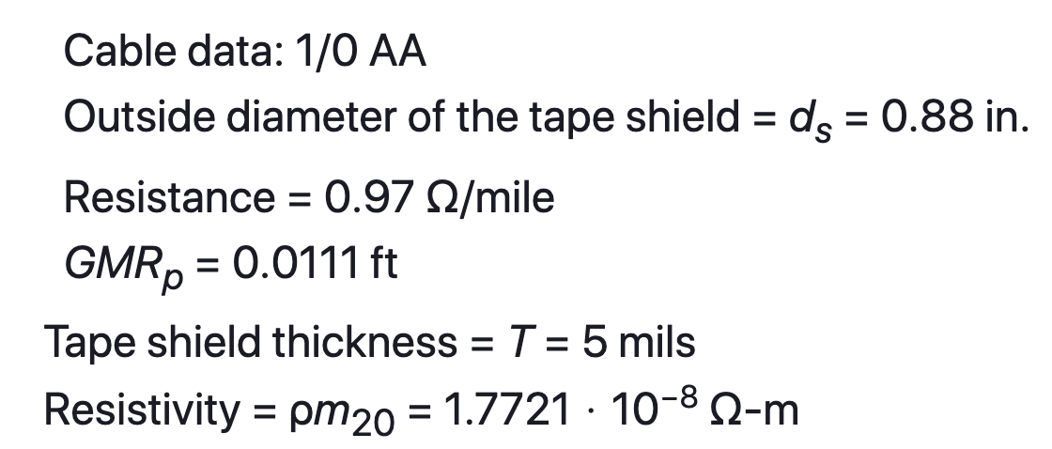
Tape-Shielded Cables
Module #3
For the phase conductor

Slide 44
Tape-Shielded Cables
Module #3

Slide 45

Tape-Shielded Cables
Module #3
For the neutral

Slide 46
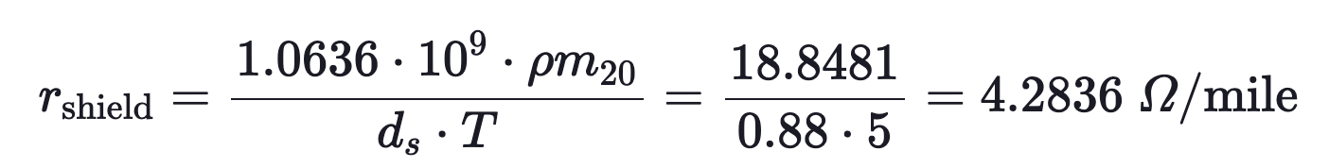
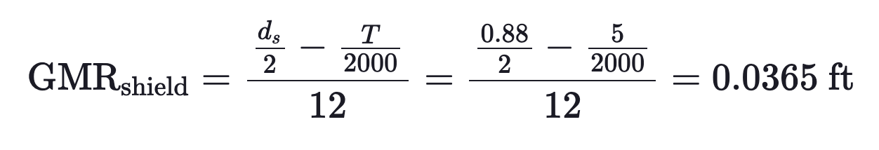
Tape-Shielded Cables
Module #3
The basic calculations are:
Resistance of the tape shield
GMR of the tape shield

Slide 47
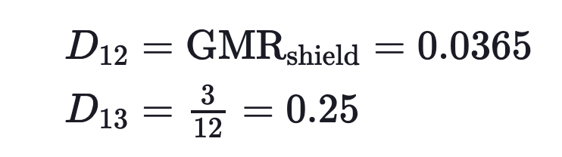
Tape-Shielded Cables
Module #3
The conductors are numbered such that:
#1 = 1/0 AA conductor
#2 = tape shield
#3 = 1/0 copper ground

Slide 48
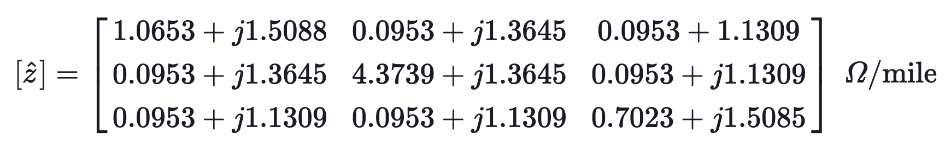
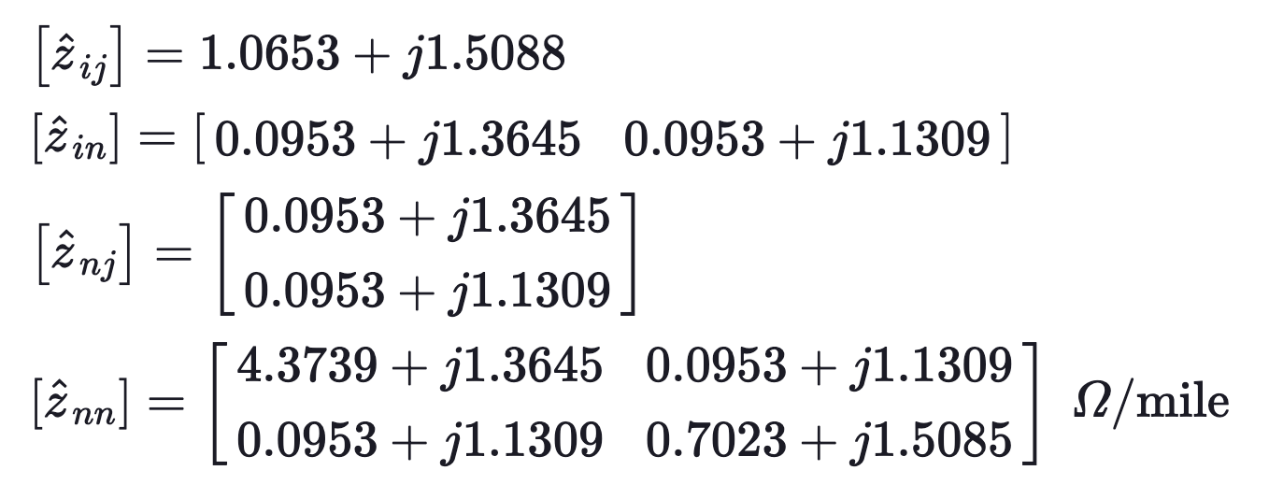
Tape-Shielded Cables
Module #3
Then just use Carson’s equations to get
Partitioned as

Slide 49
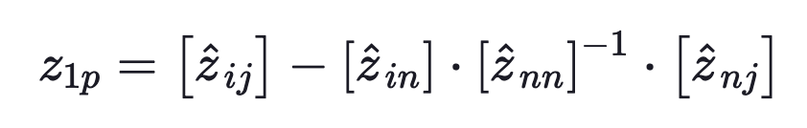
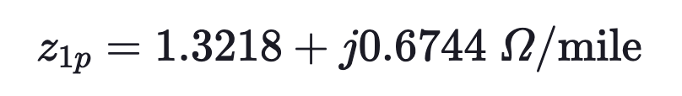
Tape-Shielded Cables
Module #3
And performing the Kron reduction

Slide 50
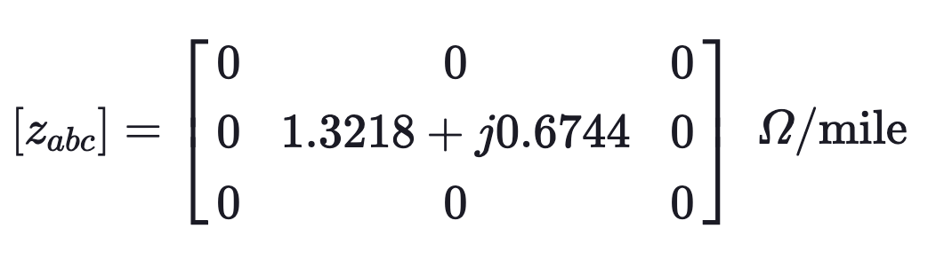
Tape-Shielded Cables
Module #3
And finally the phase matrix, will only have one row and one column of non-zero values

Slide 51
Tape-Shielded Cables
Module #3
Question: The tape thickness for a tape-shielded cable in general is equal to
0.005 inches
0.05 inches
0.5 inches
5 inches
None of the above

Slide 52
Module #4
Parallel Underground Lines

Slide 53
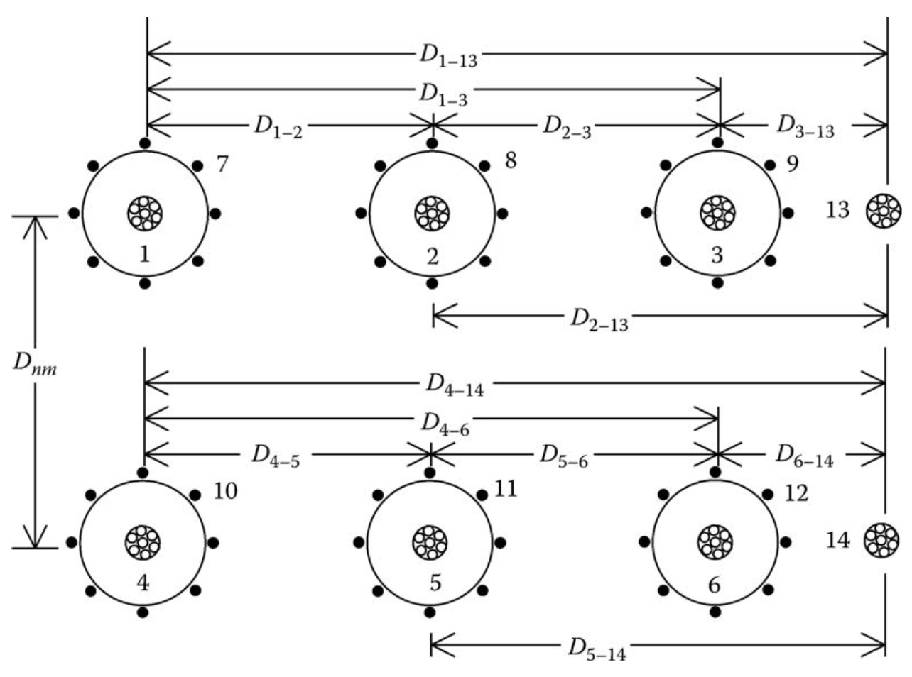
Parallel Underground Lines
Module #4
The procedure for computing the phase impedance matrix for two overhead parallel lines has been presented in a previous lection. The figure below two concentric neutral parallel lines each with a separate grounded neutral conductor.

Slide 54
Parallel Underground Lines
Module #4
The same process for calculating parallel overhead lines would be used, however this would result in a 14 x 14 primitive impedance matrix

Slide 55
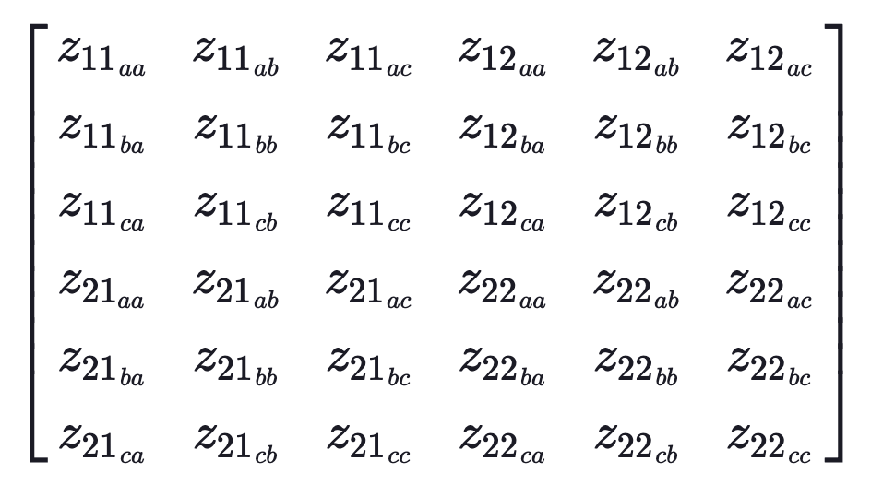
Parallel Underground Lines
Module #4
After the Kron reduction is performed, the following matrix would be produced

Slide 56
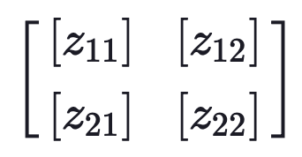
Parallel Underground Lines
Module #4
Or equivalently

Slide 57
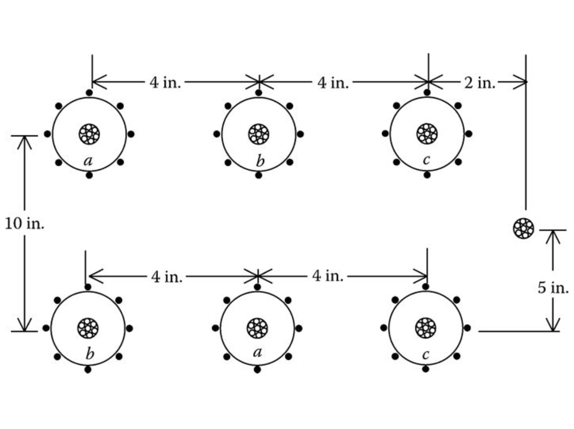
Parallel Underground Lines
Module #4
Question: The size of the primitive impedance matrix for the following set of parallel underground lines is _____ x _____

Slide 58
Parallel Underground Lines
Module #4
Question: After the Kron reduction is produced, the size of the phase impedance matrix for the following set of parallel underground lines is _____ x _____

